Slide 1



VESPERA
VESPERA
INNOVATIVE PAYMENT

Slide 2

MOTIVATION
VESPERA
APTOS MONEY CHAIN
PAYMENT FINANCE
BUY NOW, PAY NEVER
2024.7, PayFi was introduced by Solana Foundation, during EthCC conference.
Buy

Slide 3
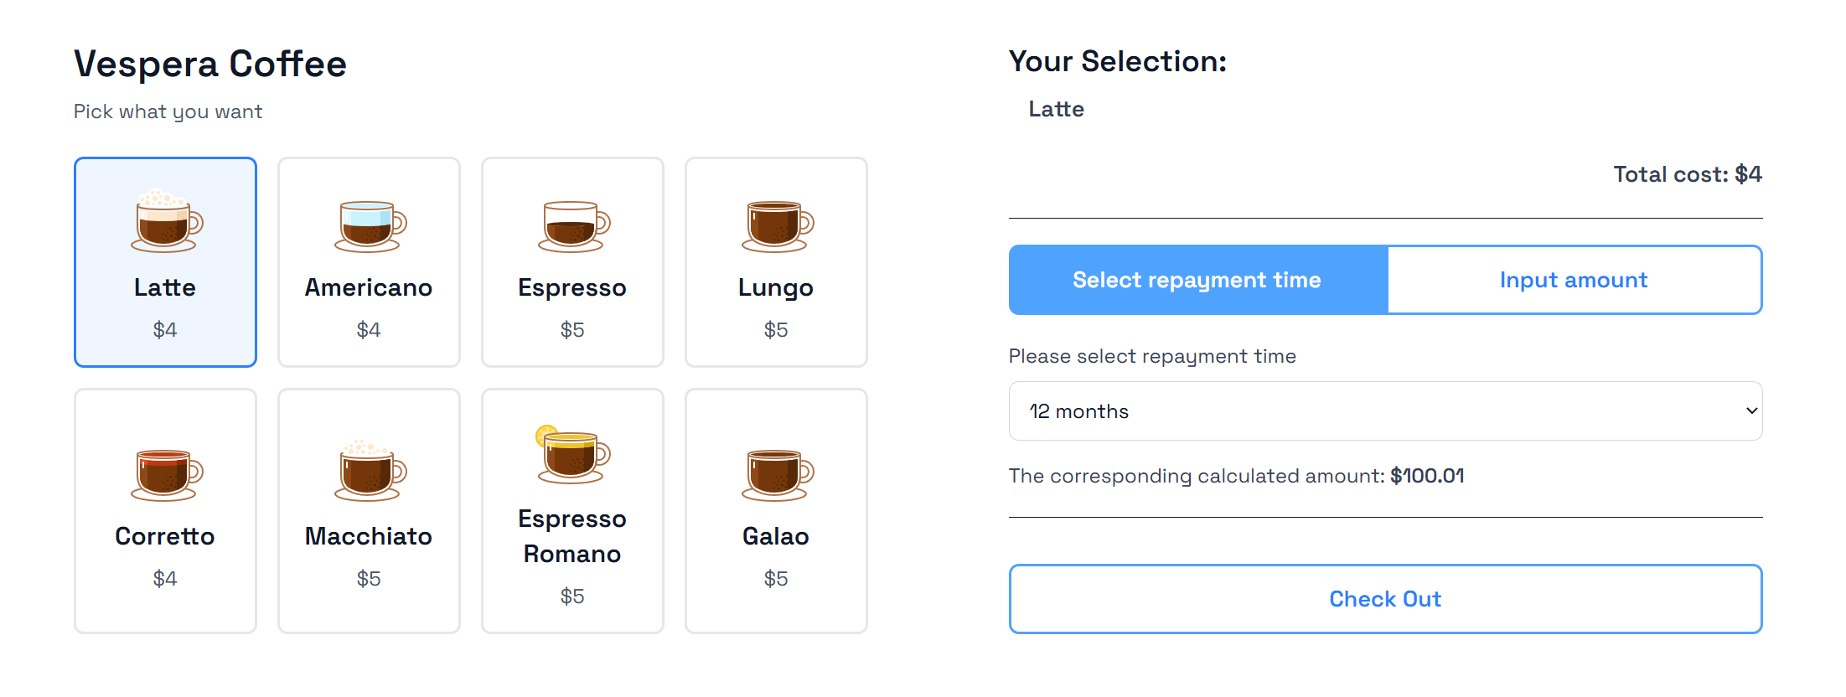
VESPERA
VESPERA
FUND NOW, PAY NEVER

Slide 4
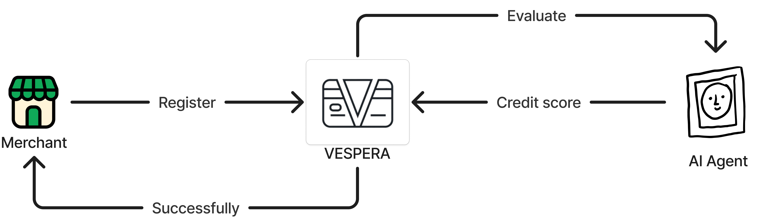
PAYMENT MODEL
VESPERA
Merchant Register

Slide 5
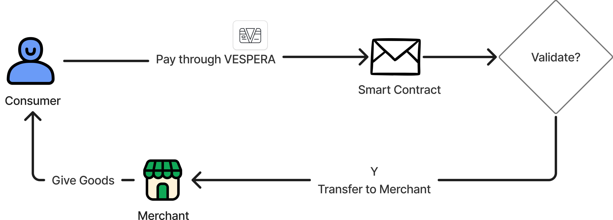
PAYMENT MODEL
VESPERA
Consumer Purchase

Slide 6
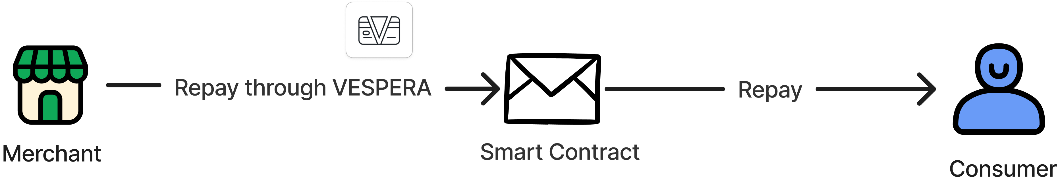
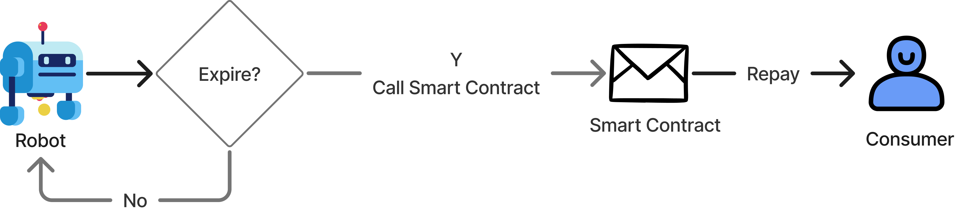
PAYMENT MODEL
VESPERA
Merchant Repay
Before Expire
Expired

Slide 7
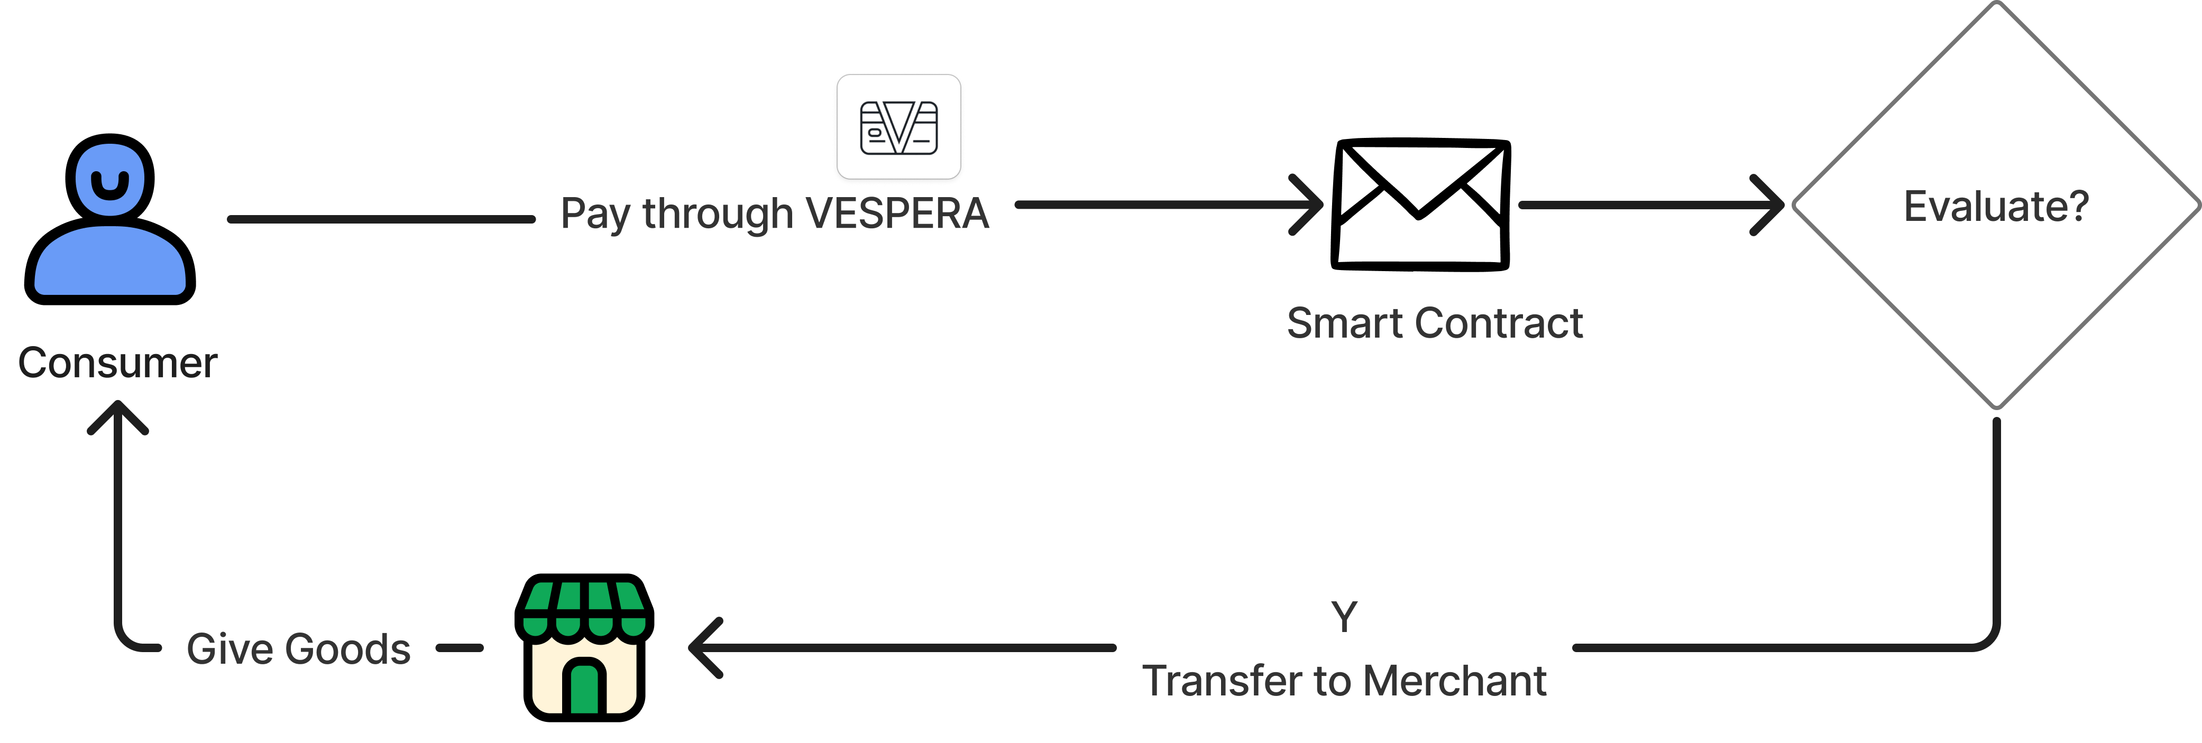
PAYMENT MODEL
VESPERA

Slide 8


APTOS CONTRACT
VESPERA
Aptos Connect
With Aptos Connect, users can log in with Google — no wallet needed — making it easier for newcomers to join and explore the Aptos ecosystem.
Aptos SDK
We use the Aptos SDK to query on-chain data and verify transactions, enhancing both the reliability and security of our platform.

Slide 9



GO-TO-MARKET STRATEGY MAP
VESPERA
Target Users
Value Proposition
Revenue Model
Primarily merchants who support crypto payments, face fundraising challenges, or aim to accelerate fundraising and quickly reinvest in production.
We provide efficient payment services via the Aptos network. Merchants can obtain temporary usage rights to certain assets by offering free services, thereby enabling rapid reinvestment and production.
We generate steady and sustainable income by charging transaction fees.

Slide 10
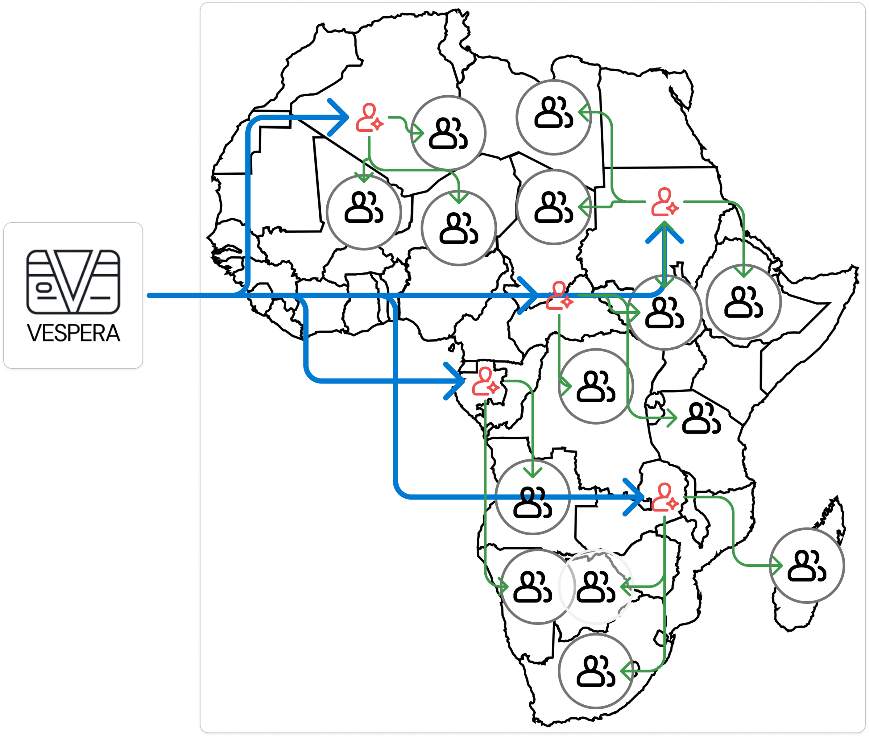
GO-TO-MARKET STRATEGY MAP
VESPERA
STEP 1
Connect BD
STEP 2
Connect OTC
STEP 3
Connect Local

Slide 11
VESPERA
VESPERA
FUND NOW, PAY NEVER

